Slide 1

GOAC
Reporting Analytic Project
Lenoir-Rhyne University
Kelsey Willett

Slide 2
Overview
Goals:
  Mass Merchandising Comprehension
    Special attention to advertising promotions
  Corporate Accounts Organizing
  Service Bureau Efficiency
  Inventory and Delivery Management
Needs:
  Better Feedback
    As described by John Deal, Retail Stores Manager

Slide 3
Representation of Sales Data
Birthdate
City
Street Address
ZIP Code
State
Name
Customer Number
Phone Number
Product Category Code
Product Line
Product Name
Size of Product Package
Promotional Code
Number Sold
Unit Price
Store City
Store Name
Store Established Date
Store ID
Store Level
Store Manager
Manager’s Phone Number
Store Name
Store Number
Store ZIP Code
Store Stare
Store Address
Date of Sale

Slide 4
Representation of Customer Data
Customer Number
Customer ID
Customer Income Level

Slide 5
Representation of Product Data
Product ID
Product Name
Product SKU
Cost per Unit
Date Product was Introduced

Slide 6
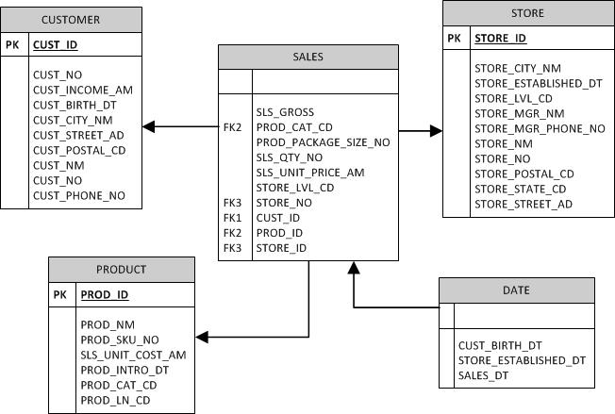
Simplified Data Model

Slide 7
Reports Needed
Sales Reports Categorized By:
  Product Category
    Displays data in Category, Date, Store ID, Promo, Unit Price, Line, Product Name
  Month and Store
    Displays Month, Date, Store Id, Store Name, City, State, Zip Code, Store Manager, Manager's Phone Number

